Slide 1

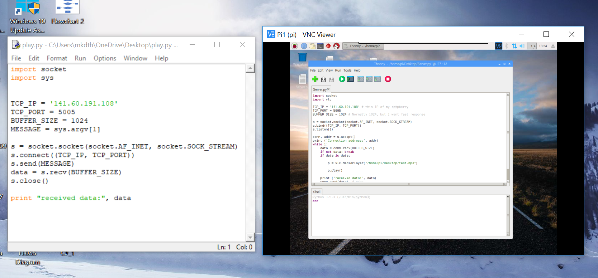
Sprint 1- Completed Tasks
Visualized Windows IoT device in web browser using Windows Device Portal(allows device management), also installed Azure Dashboard, but unable to subscribe IoT hub!
Started Learning Python programming, especially Socket programming, used for sending and receiving messages between client(PC) and Server(Raspberry) through TCP/IP (Installed VNC client)

Slide 2
Sprint 1- Completed Tasks
Informed about advantages and basic commands in Linux
Connected Windows IOT core device to “Windows Visual studio”, also coded a very simple GUI application using C language!
Got to know, how to set up temp. sensor to pi and send some data to IoT Hub
Informed a lot about LoRaWan network standard and building own gateway connected with TTN server or creation of our own server (tabled in chart & some paper works)
Replaced Windows 10 IoT core with rasbian for new tutorial “Mosquito MQTT Broker & Node-red”.
Installed & configured Mosquito MQTT server & Node-red, programmed to blink LED in raspberry pi using Node-red (To use MQTT node we should have access to a free MQTT broker or have installed own broker: http://www.hivemq.com/showcase/public-mqtt-broker/)

Slide 3
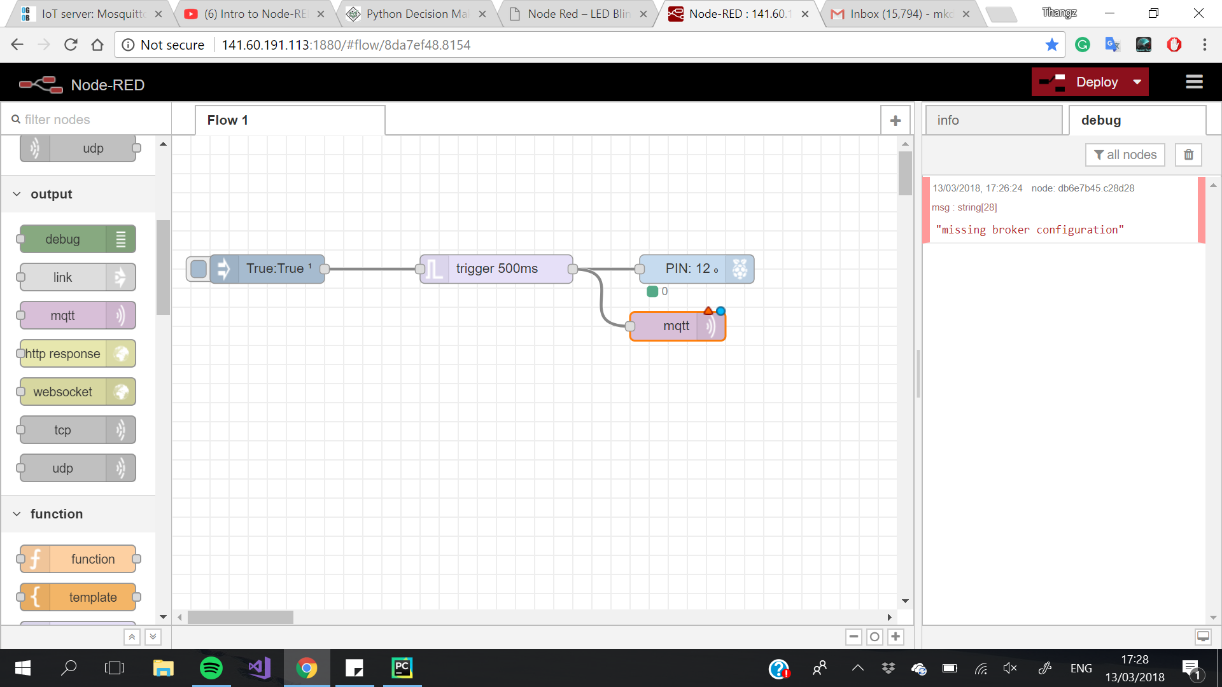
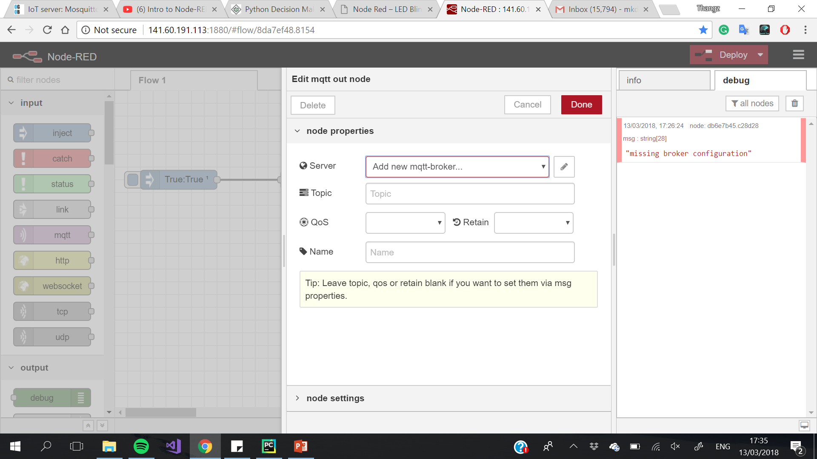
Sprint 1- Completed Tasks

